Slide 1
Computer Vision
Part 4: One-Stage Object Detection
ADF – Start 08:30

Slide 2

Agenda
Part 1: Object Localization
Part 2: Classical Object Detection
Part 3: Two-Stage Object Detection
Part 4: One-Stage Object Detection
Computer Vision

Slide 3
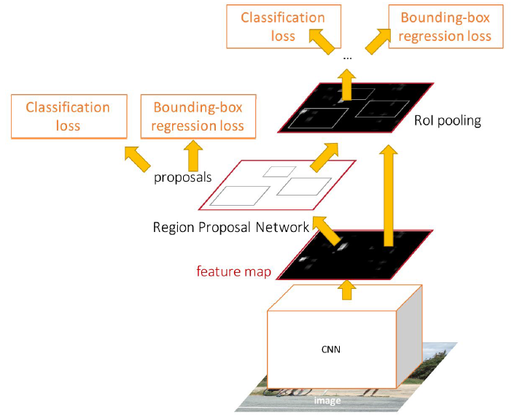
Faster R-CNN: Two-staged
First: Run per image
Backbone network
Region proposal network
Second: Run per region
Crop features: RoI pool / align
Predict object class
Prediction bbox offset
Computer Vision

Slide 4
Faster R-CNN: Two-staged
Do we really need the second stage?
Computer Vision

Slide 5

YOLO/SSD Detection
Computer Vision

Slide 6
Single-Stage Object Detection
RPN: Classify each anchor as object / not object
Single-Stage Detector: Classify each object as one of C categories (or background)
Computer Vision

Slide 7
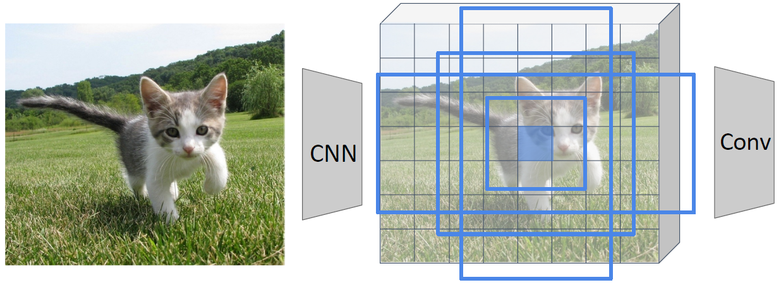
Single-Stage Object Detection
Run backbone CNN to get features aligned to input image
Remember: K anchors at each position in image feature map
Anchor category
(C+1) x K x 20 x 15
Box Transforms
4K x 20 x 15
Computer Vision

Slide 8
Single-Stage Object Detection
Sometimes use category-specific regression: Predict different box transforms for each category
Anchor category
(C+1) x K x 20 x 15
Box Transforms
C x 4K x 20 x 15
Computer Vision

Slide 9
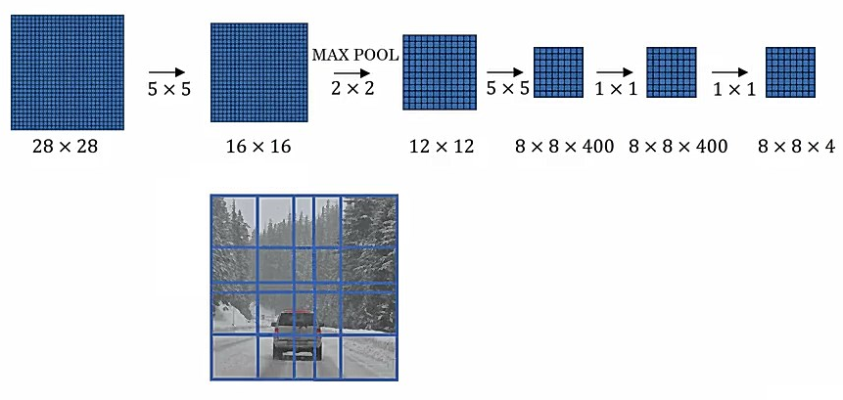
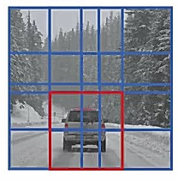
Recall OverFeat
14
14
[Sermanet et al, “Integrated Recognition, Localization and Detection using Convolutional Networks”, ICLR 2014]
Computer Vision

Slide 10
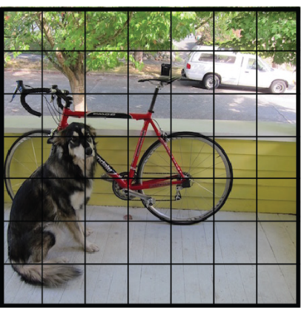
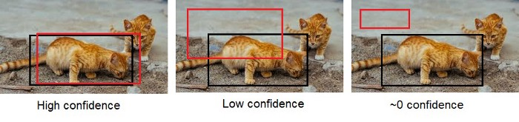
Detection as Regression
Divide image into S x S grid
Within each grid cell predict:
B Bounding Boxes: each 4 coordinates + confidence
Class scores: C numbers
Regression from image to S x S x (5 * B + C) tensor
Direct prediction using a CNN
[Redmon et al, “You Only Look Once: Unified, Real-Time Object Detection”, arXiv 2015]
Computer Vision

Slide 11
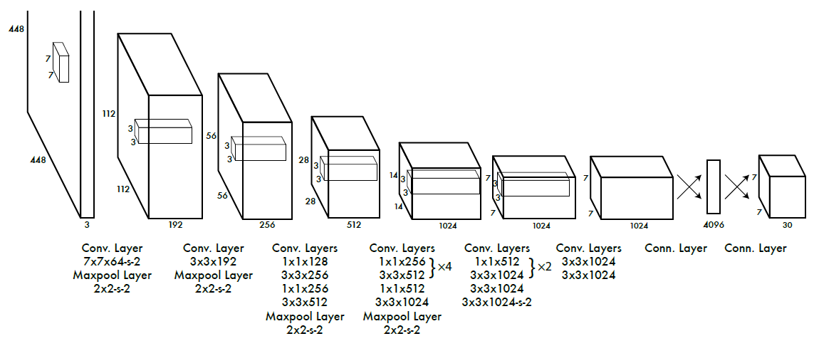
You Only Look Once
[Redmon et al, “You Only Look Once: Unified, Real-Time Object Detection”, arXiv 2015]
Computer Vision

Slide 12
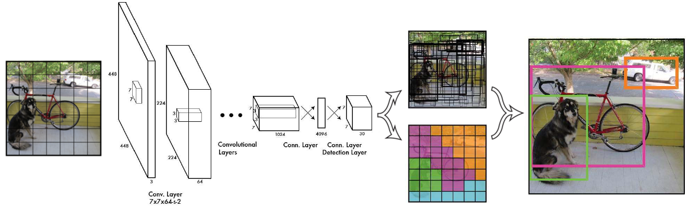
You Only Look Once
[Redmon et al, “You Only Look Once: Unified, Real-Time Object Detection”, arXiv 2015]
Computer Vision

Slide 13
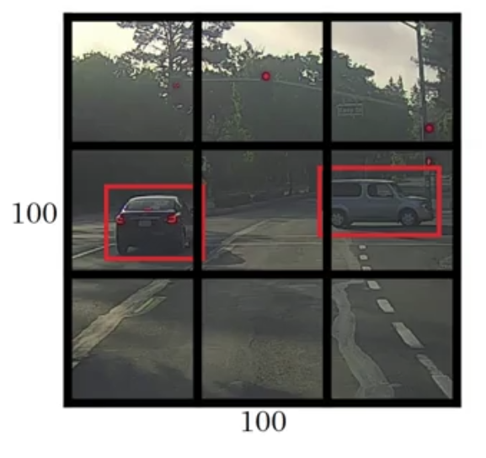
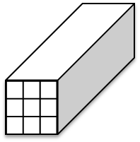
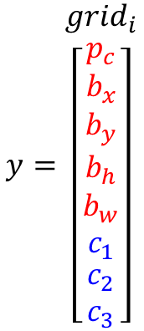
You Only Look Once
Class= [ car, pedestrian, none ]
S = 3, B = 1, C = 3
$$y=\begin{matrix}{grid}_{i} \\ \left[\begin{matrix}\begin{matrix}p_{c} \\ b_{x} \\ b_{y}\end{matrix} \\ b_{h} \\ \begin{matrix}b_{w} \\ c_{1} \\ \begin{matrix}c_{2} \\ c_{3}\end{matrix}\end{matrix}\end{matrix}\right]\end{matrix}$$
Target output =
3x3x(5*1+3)
Computer Vision

Slide 14
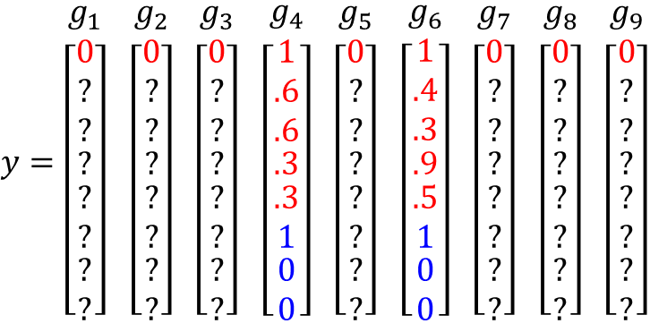
You Only Look Once
Class= [ car, pedestrian, none ]
S = 3, B = 1, C = 3
$y=\begin{matrix}g_{1} \\ \left[\begin{matrix}\begin{matrix}0 \\ ? \\ ?\end{matrix} \\ ? \\ \begin{matrix}? \\ ? \\ \begin{matrix}? \\ ?\end{matrix}\end{matrix}\end{matrix}\right]\end{matrix}$ $\begin{matrix}g_{2} \\ \left[\begin{matrix}\begin{matrix}0 \\ ? \\ ?\end{matrix} \\ ? \\ \begin{matrix}? \\ ? \\ \begin{matrix}? \\ ?\end{matrix}\end{matrix}\end{matrix}\right]\end{matrix}$ $\begin{matrix}g_{3} \\ \left[\begin{matrix}\begin{matrix}0 \\ ? \\ ?\end{matrix} \\ ? \\ \begin{matrix}? \\ ? \\ \begin{matrix}? \\ ?\end{matrix}\end{matrix}\end{matrix}\right]\end{matrix}$ $\begin{matrix}g_{4} \\ \left[\begin{matrix}\begin{matrix}1 \\ .6 \\ .6\end{matrix} \\ .3 \\ \begin{matrix}.3 \\ 1 \\ \begin{matrix}0 \\ 0\end{matrix}\end{matrix}\end{matrix}\right]\end{matrix}$ $\begin{matrix}g_{5} \\ \left[\begin{matrix}\begin{matrix}0 \\ ? \\ ?\end{matrix} \\ ? \\ \begin{matrix}? \\ ? \\ \begin{matrix}? \\ ?\end{matrix}\end{matrix}\end{matrix}\right]\end{matrix}$ $\begin{matrix}g_{6} \\ \left[\begin{matrix}\begin{matrix}1 \\ .4 \\ .3\end{matrix} \\ .9 \\ \begin{matrix}.5 \\ 1 \\ \begin{matrix}0 \\ 0\end{matrix}\end{matrix}\end{matrix}\right]\end{matrix}$ $\begin{matrix}g_{7} \\ \left[\begin{matrix}\begin{matrix}0 \\ ? \\ ?\end{matrix} \\ ? \\ \begin{matrix}? \\ ? \\ \begin{matrix}? \\ ?\end{matrix}\end{matrix}\end{matrix}\right]\end{matrix}$ $\begin{matrix}g_{8} \\ \left[\begin{matrix}\begin{matrix}0 \\ ? \\ ?\end{matrix} \\ ? \\ \begin{matrix}? \\ ? \\ \begin{matrix}? \\ ?\end{matrix}\end{matrix}\end{matrix}\right]\end{matrix}$ $\begin{matrix}g_{9} \\ \left[\begin{matrix}\begin{matrix}0 \\ ? \\ ?\end{matrix} \\ ? \\ \begin{matrix}? \\ ? \\ \begin{matrix}? \\ ?\end{matrix}\end{matrix}\end{matrix}\right]\end{matrix}$
[Redmon et al, “You Only Look Once: Unified, Real-Time Object Detection”, arXiv 2015]
Liu et al, “SSD: Single-Shot MultiBox Detector”, ECCV 2016
Computer Vision

Slide 15
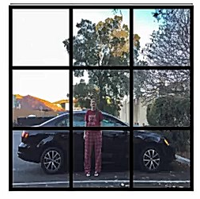
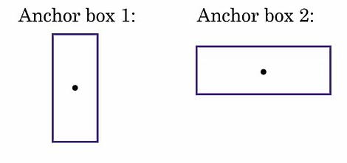
Multiple Anchor Boxes
Label: Car, Pedestrian
Computer Vision

Slide 16
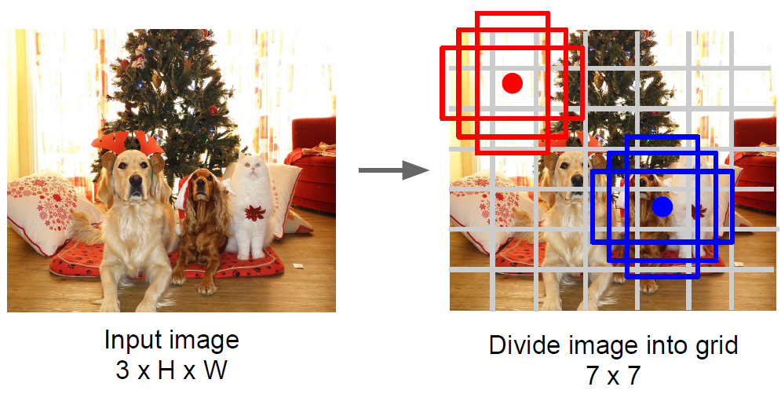
Multiple Anchor Boxes
Computer Vision

Slide 17
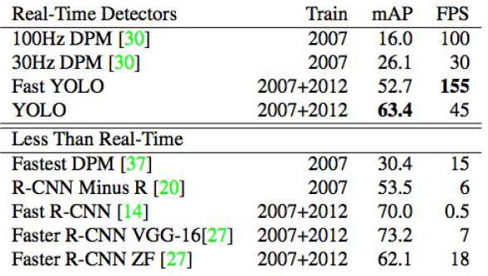
You Only Look Once
Faster than Faster R-CNN But not as good
[Redmon et al, “You Only Look Once: Unified, Real-Time Object Detection”, arXiv 2015]
Computer Vision

Slide 18
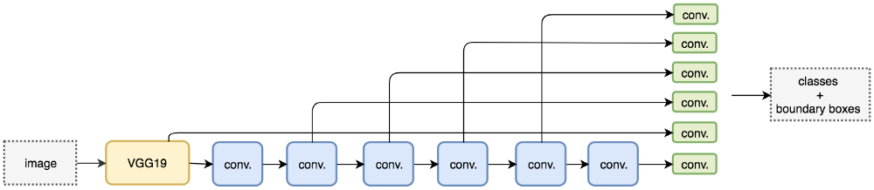
Single Shot Detector
Use VGG16
Use multi-scale object detection from multiple feature maps
Liu et al, “SSD: Single-Shot MultiBox Detector”, ECCV 2016
Computer Vision

Slide 19
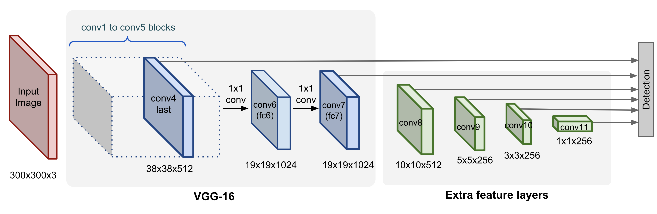
Single Shot Detector
SSD only uses upper layers for detection and therefore performs much worse for small objects.
Liu et al, “SSD: Single-Shot MultiBox Detector”, ECCV 2016
Computer Vision

Slide 20
YOLO Improvements
YOLOv2 / YOLO9000
Batch normalization
High-resolution classifier
Convolutional with Anchor Boxes
K-mean clustering of box dimensions
Direct location prediction
Multi-scale training
Light-weighted base model
YOLOv3
More complex backbone for feature extraction
Darknet + ResNet: Use 3×3 and 1×1 filters with skip connections
Feature Pyramid Networks (FPN) like Feature Pyramid
less BFLOP, same classification accuracy, 2x faster compared to ResNet-152
Computer Vision

Slide 21
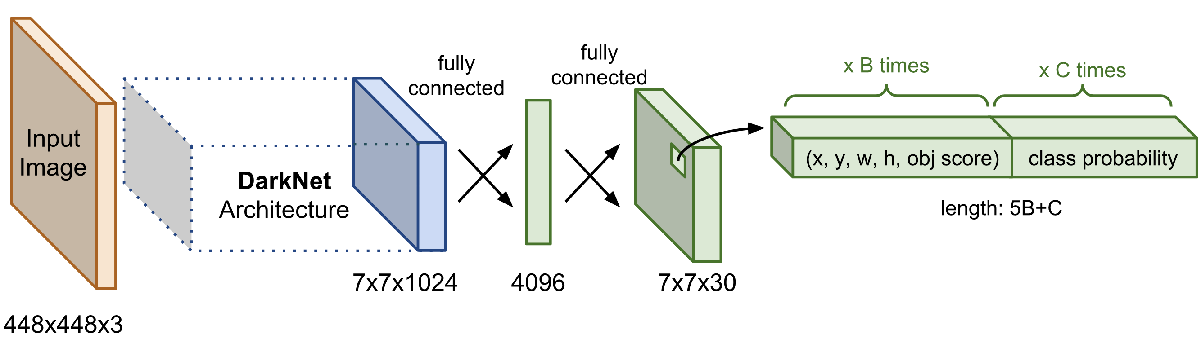
YOLOv1 Detector
Use an architecture called DarkNet
Computer Vision

Slide 22
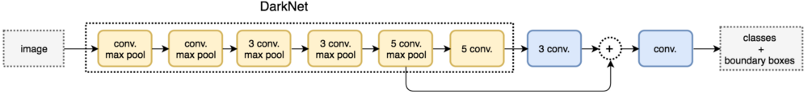
YOLOv2 Detector
Improved: DarkNet-19
Partially flattens features maps and concatenates it with another lower resolution maps
Computer Vision

Slide 23
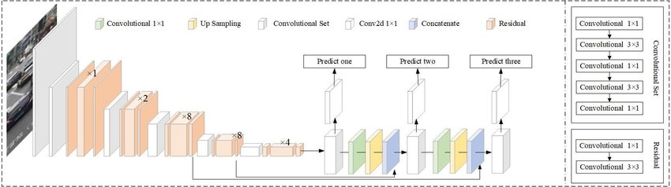
YOLOv3 Detector
Improved: DarkNet-53
predicts boxes at 3 different scales
Computer Vision

Slide 24
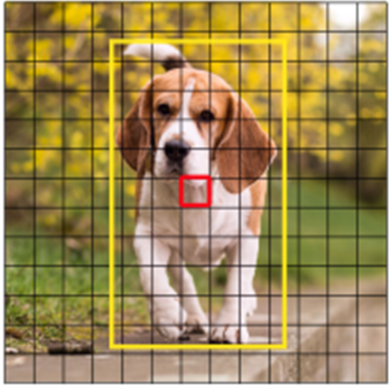
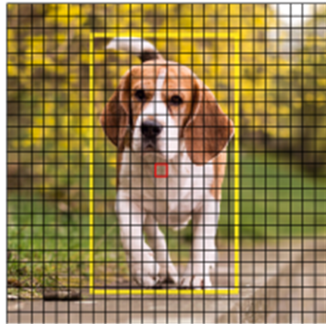
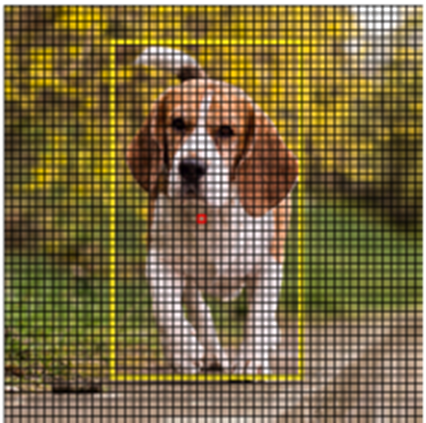
YOLOv3 Detector
Improved: DarkNet-53
predicts boxes at 3 different scales
13x13
26x26
52x52
Computer Vision

Slide 25
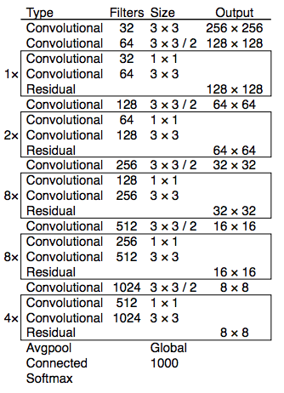
DarkNet-53
DarkNet + ResNet
3×3 and 1×1 filters with skip connections
less BFLOP, same classification accuracy, 2x faster compared to ResNet-152
Computer Vision

Slide 26
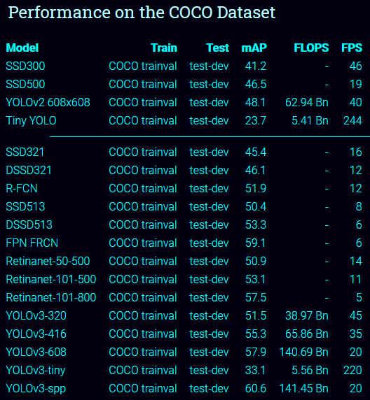
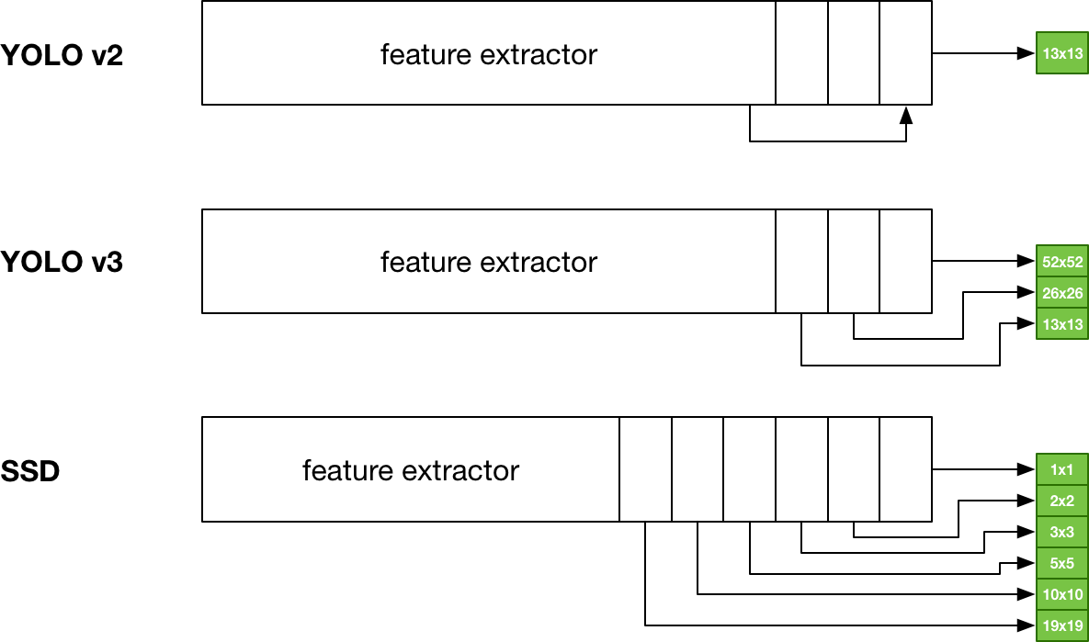
YOLO vs SSD
Computer Vision

Slide 27
Recap
Computer Vision

Slide 28
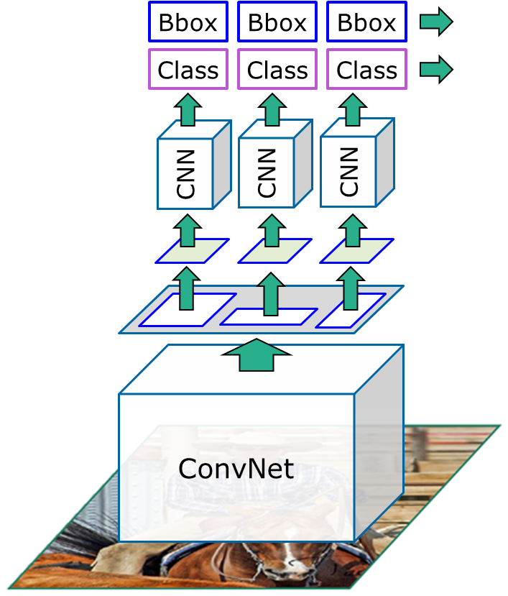
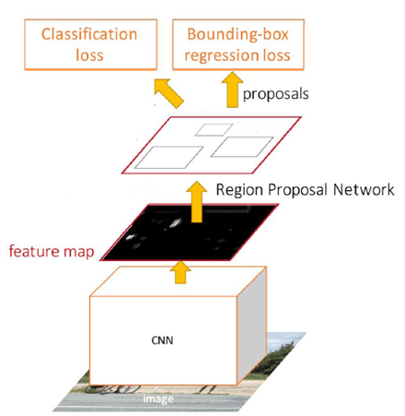
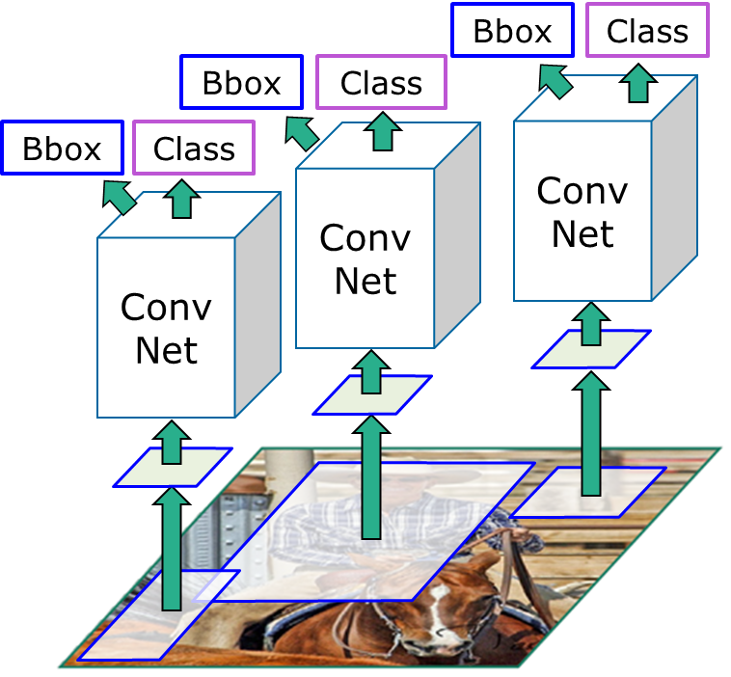
TL;DR
“Slow” R-CNN:
Run CNN independently for each region
Fast R-CNN:
Apply differentiable cropping to shared image features
Faster R-CNN:
Compute proposals
with CNN
Single-Stage:
Fully convolutional
detector
Computer Vision

Slide 29
TL;DR – Localization
Find a fixed number of objects (one or many)
L2 regression from CNN features to box coordinates
Much simpler than detection
Overfeat: Regression + efficient sliding window
Deeper networks do better
Computer Vision

Slide 30
TL;DR – Object Detection
Find a variable number of objects by classifying image regions
Before CNNs:
dense multiscale sliding window (HoG, DPM)
Avoid dense sliding window with region proposals
Computer Vision

Slide 31
TL;DR – Object Detection
R-CNN:
Selective Search + CNN classification / regression
Probably don’t use this; too slow
Fast R-CNN:
Swap order of convolutions and region extraction
Computer Vision

Slide 32
TL;DR – Object Detection
Faster R-CNN:
Compute region proposals within the network
Slower than YOLO but more accurate
YOLO/SSD
Go from input image to tensor of scores with one big convolutional network
faster but not as accurate
Deeper networks do better
Computer Vision

Slide 33
Object Detection: Lots of variables
Backbone architecture used
Input resolution
Crop resolution
Number of anchors
Size of anchors
IoU threshold
Computer Vision

Slide 34
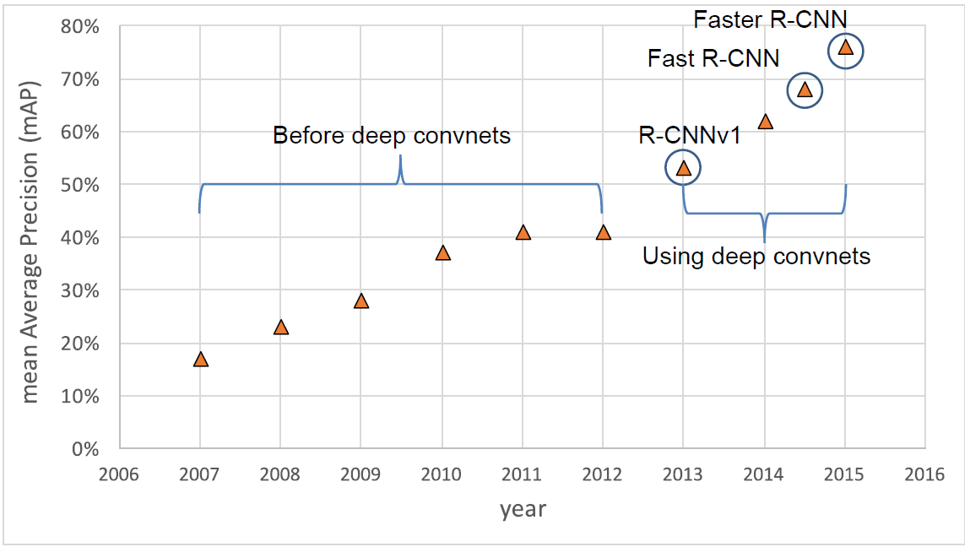
Object Detection Progress
Computer Vision

Slide 35
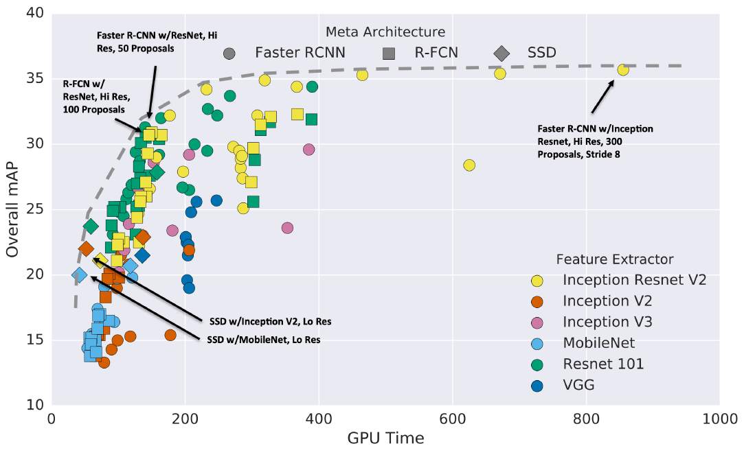
Object Detection Progress
Huang et al, “Speed/accuracy trade-offs for modern convolutional object detectors”, CVPR 2017
Computer Vision

Slide 36
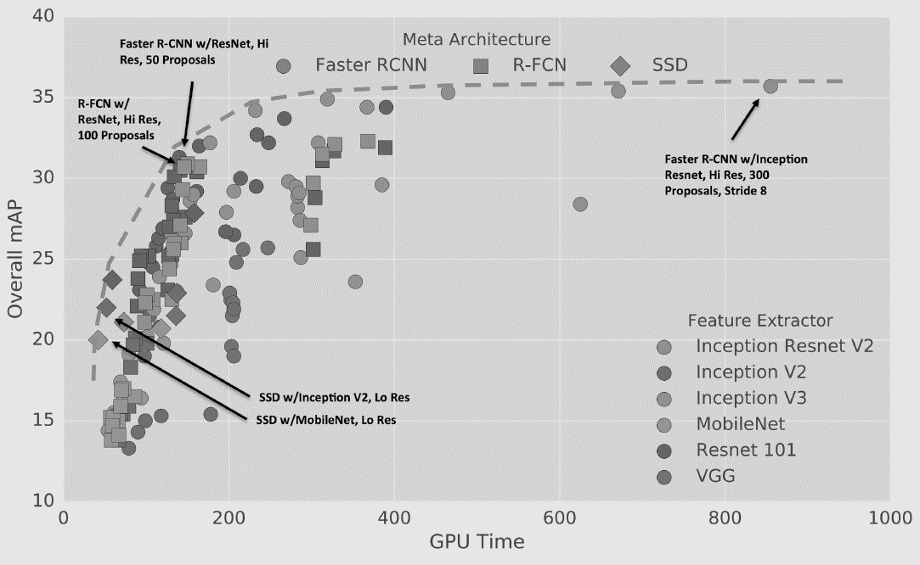
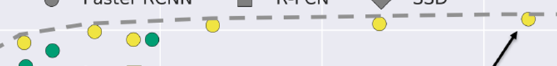

Object Detection Progress
Takeaways:
Two stage method (Faster R-CNN) get the best accuracy, but are slower
Single-stage methods (SSD) are much faster, but don’t perform as well
Huang et al, “Speed/accuracy trade-offs for modern convolutional object detectors”, CVPR 2017
Computer Vision

Slide 37
Object Detection Progress
Takeaways:
Bigger backbones improve performance, but are slower
Diminishing returns for slower methods
Huang et al, “Speed/accuracy trade-offs for modern convolutional object detectors”, CVPR 2017
Computer Vision

Slide 38
Recent Advancement
GPUs have gotten faster, Train Longer
Improved performance with many tricks
Multiscale backbone: Feature Pyramid Networks
Better backbone: ResNeXt-101
Single-Stage methods have improved
Very big models work better
Test-time augmentation pushes numbers up
Big ensembles, more data, etc.
Computer Vision

Slide 39
New Entries:
Faster R-CNN w/ResNet-101-FPN, longer training (63ms, 42.0 mAP)
Faster R-CNN w/ResNeXt-101-FPN, longer training (120ms, 43.0 mAP)
RetinaNet (SSD-like) w/ResNet-101 (80ms, 39.9 mAP)
Mask R-CNN w/RexNeXt-152 (281 ms, 49.3 mAP)
Mask R-CNN w/RexNeXt-152 +Test-time augmentation (? ms, 51.4 mAP)
Current leaderboard winner: 58-60 mAP https://competitions.codalab.org/competitions/20794#results
Computer Vision

Slide 40
Object Detection: Open-Source Code
TensorFlow Detection API:
https://github.com/tensorflow/models/tree/master/research/object_detection
Faster R-CNN, SSD, RFCN, Mask R-CNN
Detectron2 (PyTorch):
https://github.com/facebookresearch/detectron2
Fast / Faster / Mask R-CNN, RetinaNet
Computer Vision

Slide 41

Question?
Computer Vision

Slide 42

Next Agenda
More Detection
Segmentation
Computer Vision

Slide 43
References
Fei-Fei Li, Justin J, Serena Y - Stanford CS231n 2018 Course
Justin Johnson– EECS498 Lectures, University of Michigan
Yogesh Singh Rawat – CAP5415 Lectures, University of Central Florida
Grauman, K. and Leibe, B. 2011. Visual Object Recognition. Synthesis Lectures Artif. Intell. Mach. Learn. 5, 1 181
Computer Vision
Notes:
http://jefkine.com/general/2016/09/05/backpropagation-in-convolutional-neural-networks/
https://grzegorzgwardys.wordpress.com/2016/04/22/8/
http://andrew.gibiansky.com/blog/machine-learning/convolutional-neural-networks
http://www.slideshare.net/kuwajima/cnnbp
http://soumith.ch/ex/pages/2014/08/07/why-rotate-weights-convolution-gradient

